Slide 1


INTERNAL ONLY
PLP Launch Summary -
Marketing Team, October 2022

Slide 2

SUMMARY
Product Launch Plan Smart Ads Platform (Self-Serve) Document in Notion
Business Case for Self-Serve
Objective
Competition
Target User Profile
Product Features
Marketing Tactics
Role of Sales

Slide 3
Business Case
Moving into self-serve ads allows us to accomplish a few things:
XXXX
XXXX
XXXX
XXXX

Slide 4
Objective
Acquire XX beta-customers by EOY 2022.

Slide 5
Competition
 | Mayan (SAP) | Competitor A | Competitor B | Competitor C
Cost | $199 + 5% of ad spend, per month | $XX per month + X% ad spend + $0.30 per tracked search term (first 50 free) | Flat fee ($XXXX for up to $XX,000 per month in ad spend) | $XXX/month (up to Xk ad spend per month)
Minimum ad spend? | 1-2k ad spend | ?? | ?? | Up to Xk ad spend
What’s included | Onboarding call | 30 Day Free Trial (it’s not explicit but customers say its included) | Client success manager | Onboarding call Competitor C Slack Community
Competitive features | Adjust bids for Top of Search and Product Pages more quickly, and stick out above the competition | Inventory optimization Negative keywords Hourly bid optimizations | Hourly bid optimizations | Hourly bid optimizations Negative keywords Influencer marketing feature

Slide 6
Target User Profile
For a more detailed description, visit the Product Launch Plan.
 | Smart Ads Platform User | Premium Ad Management Service
High Level Description | Intermediate Seller | Advanced Seller
Ad Spend per Month | $1-2k | $2k+
Benefits/Key Values | Price sensitive, but need performance to scale | Wants to save time and augment team to drive performance Time efficiency: Focused on scaling but doesn’t want to worry about ads

Slide 7
Product Features
Feature | Description | Use Cases | Notion
Bulk change placement adjustments | Adjust bids for Top of Search and Product Pages more quickly, and stick out above the competition | As a seller, you want to be one of the first products that is visible/seen when a customer searches on Amazon. Our feature allows you to adjust placements to capture higher-converting traffic. This is a huge competitive advantage of ours and a core part of our advertising strategy. | LINK
Day of week bid optimizations | Optimize bids on high performing days and lower spend when performance tends to be down, responding to trends in daily performance | If you sell party supplies, you may see really bad performance over the weekend, but really good performance on Tuesday to Thursday. This is because customers get 2 day shipping for the party happening on the weekend. So you can simply adjust bids for day of the week. | LINK
Competitor Product Targeting | Expands the competition you advertise against so that you have greater overall market coverage | Example: you can target a competitor Superman Funko toy with five Superman shirt designs. With a high bid, you can show up multiple times and in the prime position in the "sponsored products related to this item" section. The idea is that someone who wants a Superman toy might also want a Superman T-shirt. | LINK

Slide 8
Product Features
Feature | Description | Use Cases | Notion Details Link
Keyword Discovery | Leverages Natural Language Processing (NLP) to help expand the keywords that are targeted per product | Amazon does not offer keyword research tool, researching keywords manually takes up a lot of time and effort. But you cannot fully rely on AI to select keywords - example, for a dog bowl product, “farm house dog bowl” as a suggested keyword may not be a good fit. | LINK
Automated Full Campaign Coverage | Automated Campaign Coverage = Keyword Discovery, Category targeting, Competitor Product Targeting. Distributes high performing keywords amongst exact, broad, phrase, ASIN, and Category targeting. | Mayan’s automated campaign coverage balances being granular enough to allow for targeted approaches (it’s not a “one size fits all” approach), but not granular to where it doesn’t make sense and becomes a mess. Also, unlike what is offered on Amazon Seller Central, Mayan’s tool prevents Amazon from being able to increase bids by 100%. This is important because it means you will not overspend your budget. | LINK

Slide 9
Product Features
Feature | Description | Use Cases | Notion
Inventory Informed Actions | Is informed of inventory activity as well as sales forecasts to respond to accordingly in advertising activity. Pause campaigns, enable campaigns | You can end up spending large amounts on advertising for a product that you no longer have in stock. It is also really difficult, especially as you have more products, to manage these details. | LINK
Category Targeting | Subset of Automated Full Campaign Coverage. Helps target categories in which to advertise the product in | Helps target categories in which to advertise the product in. For example, it helps us know that a bluetooth keyboard should be in the category of "electronics and accessories". If you have tons of products this is tedious to accomplish. | LINK

Slide 10



Marketing Tactics

Slide 11
Positioning Statement: For [insert segment] who are looking to [their goal/desire], Mayan’s self-serve advertising platform provides an [xx] and [xx] with [xx].
Target Audience: [Segment] who spend $1-2k on advertising
Core Benefit 1 | Core Benefit 2 | Core Benefit 3
Message Pillar 1: XXXXX | Message Pillar 2: XXXX | Message Pillar 3: XXXX
Proof Point: XXX | Proof Point: XXX | Proof Point: XXX
Proof Point: XXX | Proof Point: XXX | Proof Point: XXXX

Slide 12
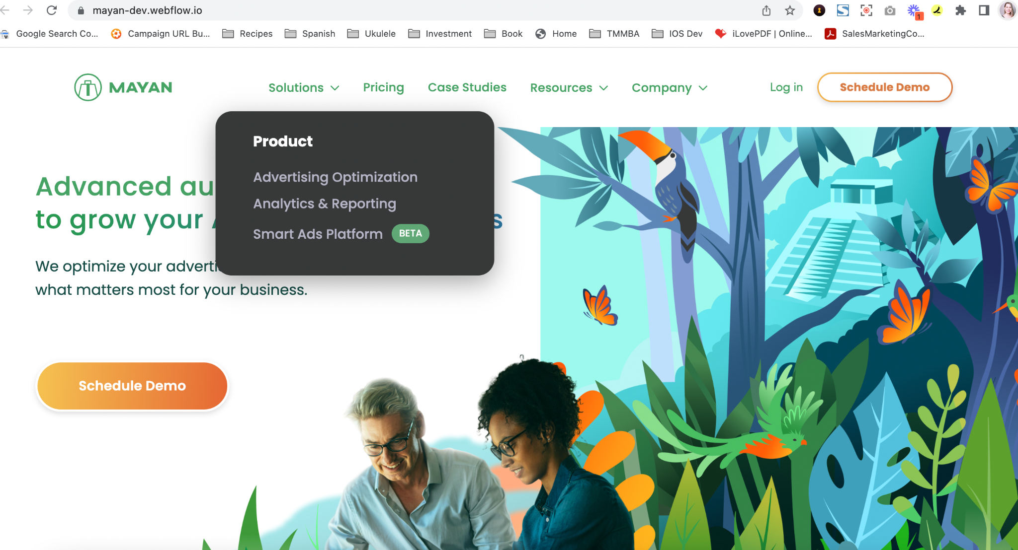
Notes:
https://mayan-dev.webflow.io/

Slide 13
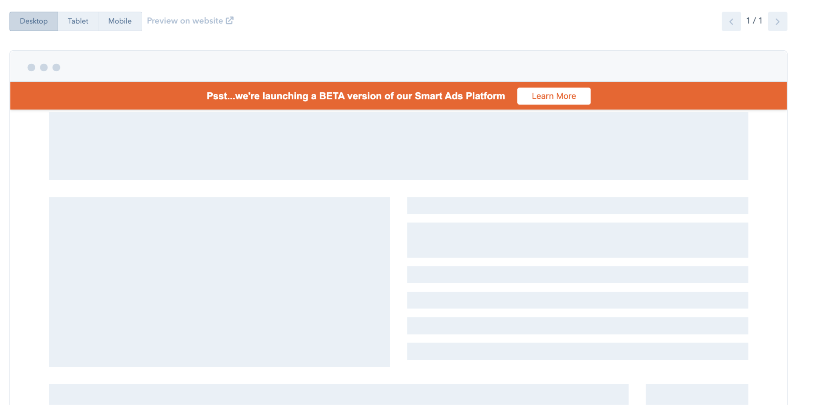
Pop-up that is on the website - leads to landing page

Slide 14
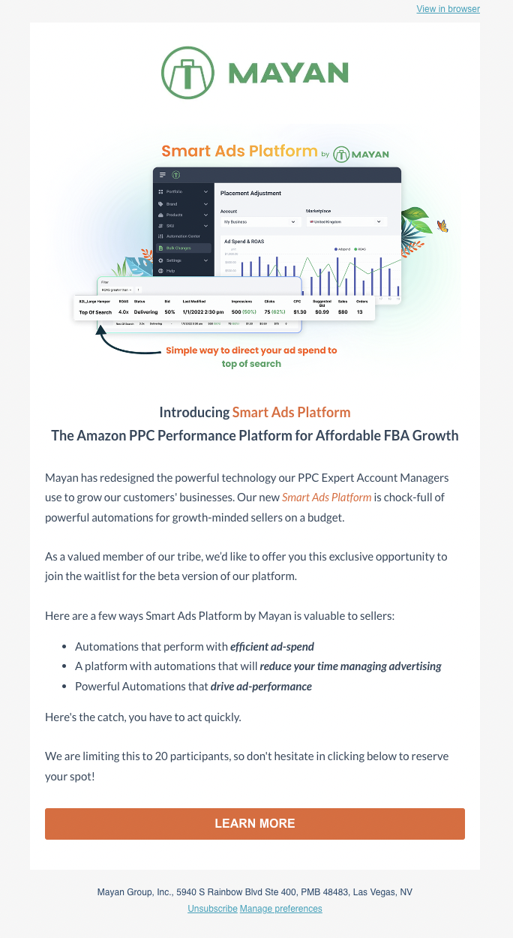
Email that will be sent to 0-1k and 1-2k ad spend (Note: NOT marked as SQLs)
This email takes you to the landing page

Slide 15
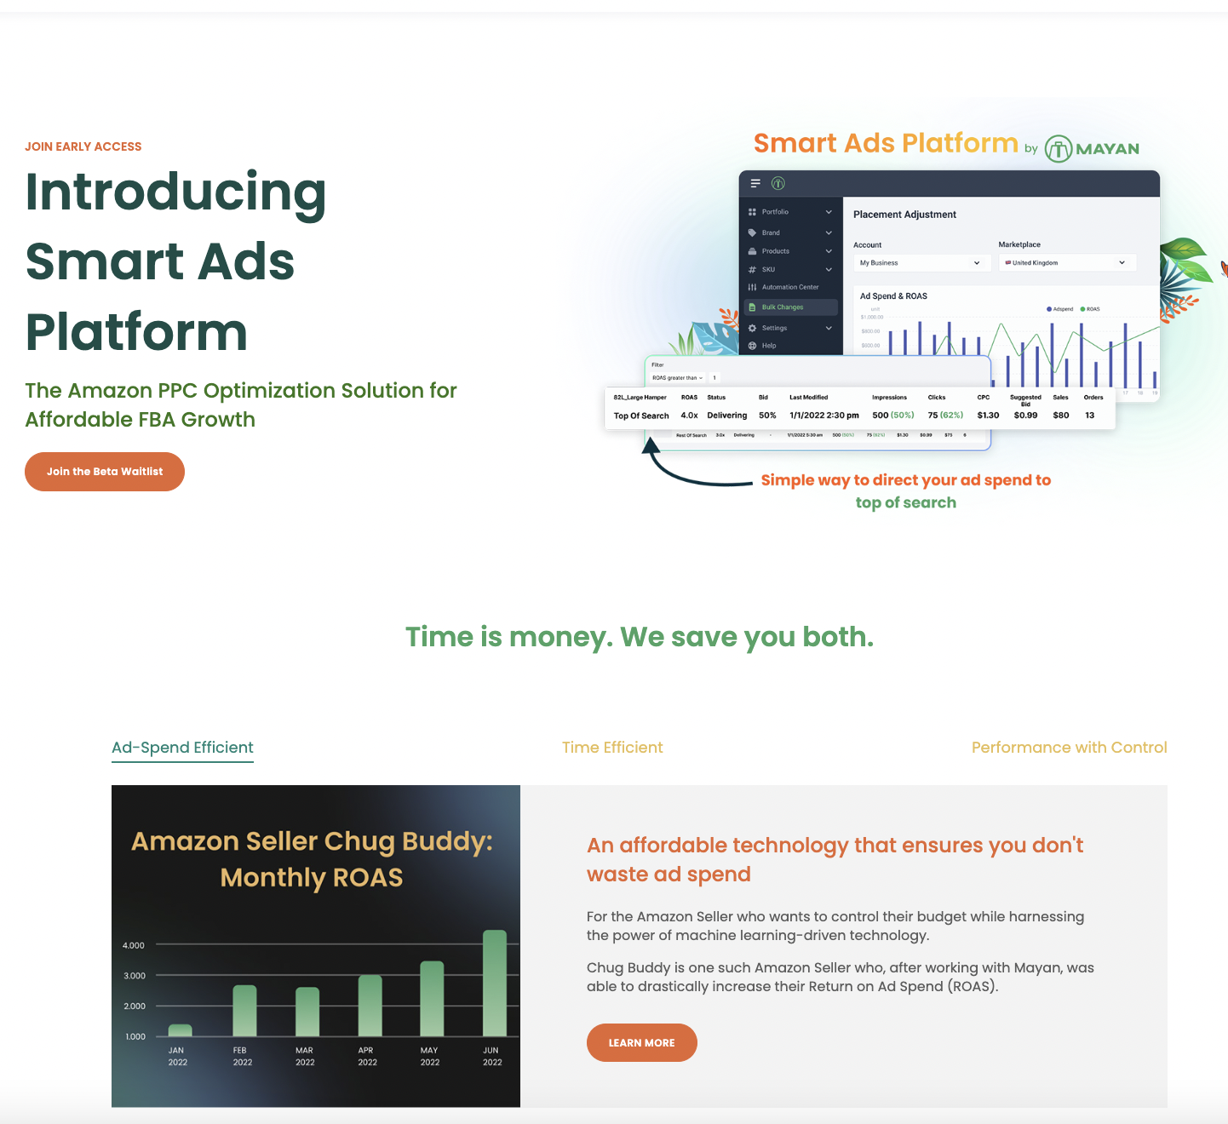
Landing Page: https://try.mayan.co/smart-ads-platform-waitlist
Notes:
https://try.mayan.co/smart-ads-platform-waitlist

Slide 16
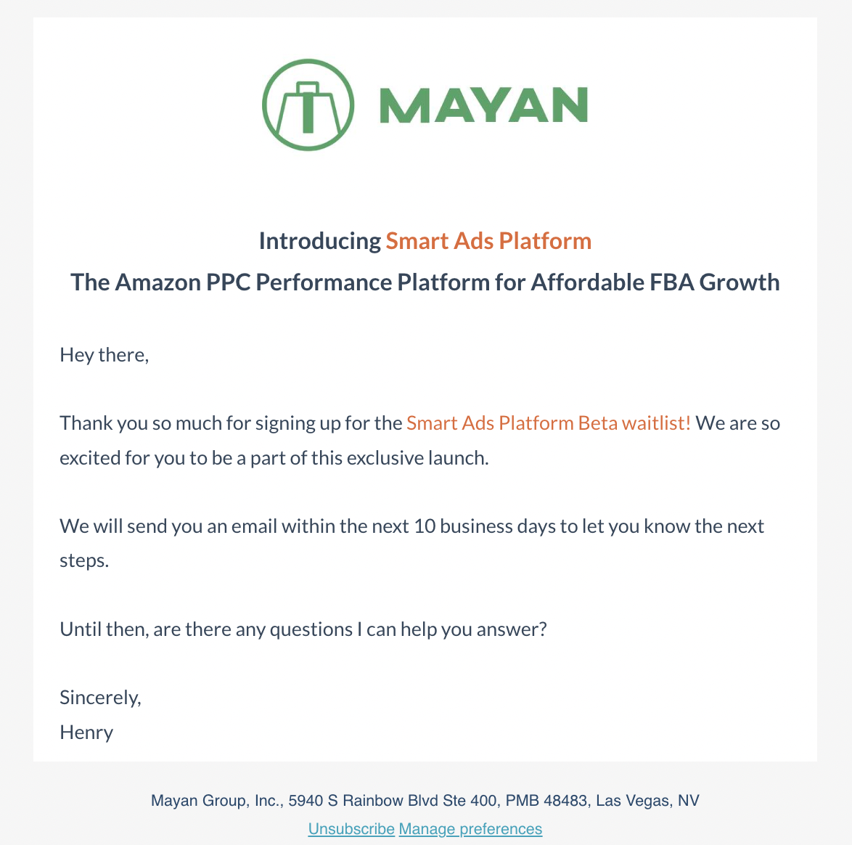
Once someone fills out the form on the landing page, they get this email in response
Note: Henry from Product will be reaching out and setting up meetings with sign-ups

Slide 17
Role of Sales

Slide 18
[Guidance for Sales team inserted here]
We had some specific guidance here for Sales – high level, since it is a beta launch, sales is not heavily involved

Slide 19
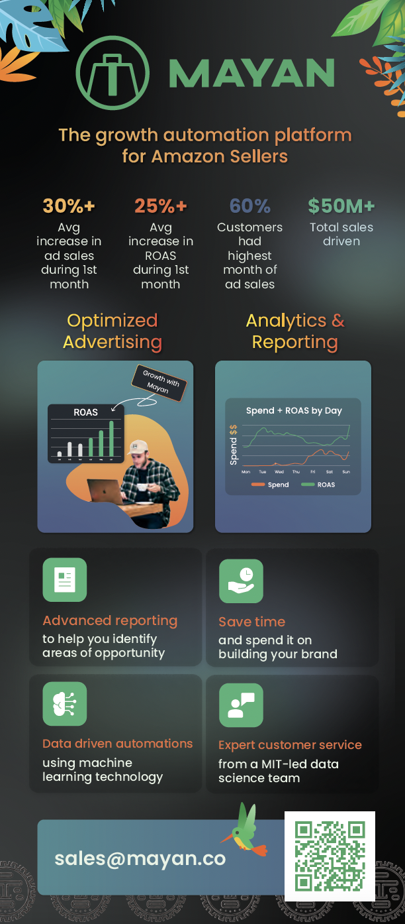
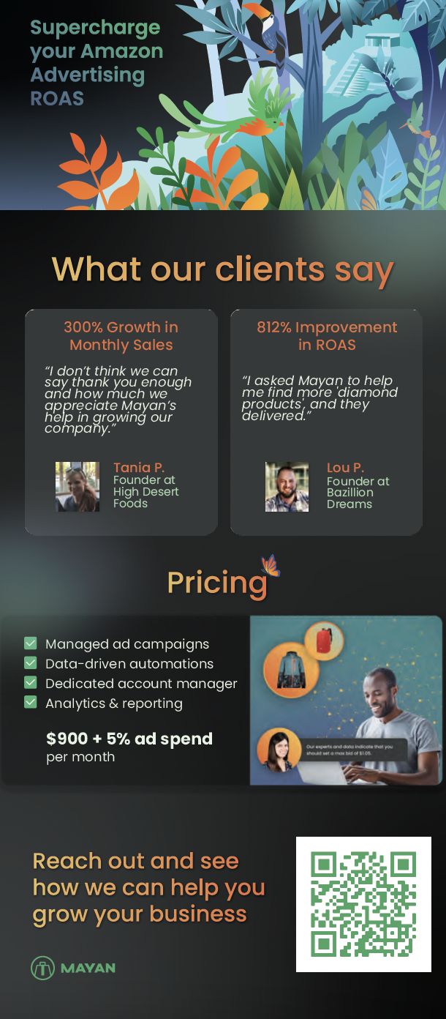
Future project - create flyer for self-serve option

